Slide 1


NODE.JS GLOBAL
DEPLOY AND TOOLS
MARCH, 2019

Slide 2





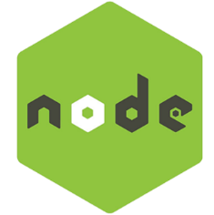
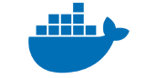


AGENDA
Development tools you may not know, but should:
ESLint
Nodemon
Postman
Fiddler
Installing Node.js on server:
PPA
NVM
Application deploy:
PaaS (Heroku)
Docker
Demonizing the application:
Forever
PM2
Q&A

Slide 3


DEVELOPMENT TOOLS. ESLINT
The primary reason ESLint was created was to allow developers to create their own linting rules.
Code linting is a type of static analysis that is frequently used to find problematic patterns or code that doesn’t adhere to certain style guidelines.
$ npm install eslint-g
$ eslint [options] [file|dir|glob]*
Can also be integrated to almost all of popular IDEs/Code editors, build tools,
Extended via shared configs from well-known companies (Airbnb, Google) and for popular technologies/frameworks (Angular, React, Jasmine)
https://github.com/airbnb/javascript
https://eslint.org/docs/user-guide/getting-started
https://github.com/eslint/eslint

Slide 4
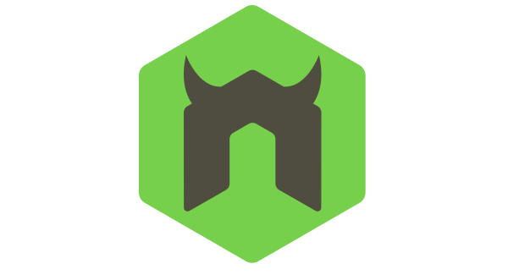

DEVELOPMENT TOOLS. NODEMON
Nodemon is a utility that will monitor for any changes in your source and automatically restart your server. Perfect for development.
$ npm install nodemon -g
And then instead of using
$ node server.js
we using
$ nodemon server.js
https://github.com/remy/nodemon

Slide 5

DEVELOPMENT TOOLS. POSTMAN
A tool that provides efficient way to work with APIs.
Features:
Composing HTTP requests (headers, auth, data)
Automated testing with collections of requests
Mock specific server data
History logging
API monitoring
https://www.getpostman.com

Slide 6

DEVELOPMENT TOOLS. FIDDLER
Web debugging proxy tool
Features:
Request proxying
Traffic recording (save log with whole requests/responses data)
Composing HTTP requests (headers, auth, data)
Performance, security testing
Customizable free tool

Slide 7
INSTALL NODE.JS ON SERVER
Simple installation
$ sudo apt-get install nodejs
$ sudo apt-get install npm
simple installation

Slide 8

INSTALL NODE.JS ON SERVER
PPA installation
$ curl https://deb.nodesource.com/setup_8.x | sudo bash
$ sudo apt-get install nodejs
simple installation
PPA

Slide 9

INSTALL NODE.JS ON SERVER
NVM
$ sudo apt-get install git build-essential libssl-dev
$ curl https://raw.githubusercontent.com/creationix/nvm/v0.31.0/install.sh | sudo bash
$ source ~/.profile
simple installation
PPA
NVM

Slide 10
INSTALL NODE.JS ON SERVER
Using NVM
$ nvm ls-remote
$ nvm install 8.4.0
$ nvm ls
$ nvm use 8.4.0
$ nvm alias default 8.4.0
$ nvm use default
$ nvm help
NVM

Slide 11


DEPLOY APPLICATION. GIT
The most simpliest way to deploy your application on server is using GIT.
$ git clone https://your-repo
$ cd your-repo-path
$ npm install
$ npm run build
$ npm start

Slide 12



DEPLOY APPLICATION. HEROKU
Heroku makes it easy to deploy and scale Node.js applications in the cloud. Run any recent version of Node.js. Deploy apps in seconds utilizing dependency caching. Easily install third-party add-ons like Redis, MongoDB & New Relic.
Fast start for developer
Easy to use
Free
App starts slow on free account
All tastiest isn’t free

Slide 13

DEPLOY APPLICATION. DOCKER
Docker allows you to package an application with all of its dependencies into a standardized unit, called a container, for software development. A container is a stripped-to-basics version of a Linux operating system. An image is software you load into a container.
Dockerfile
FROM node:carbon
WORKDIR /usr/src/app
COPY package*.json ./
RUN npm install
COPY . .
EXPOSE 8080
CMD [ "npm", "start" ]
$ docker build -t [USERNAME]/app-name .
$ docker login
$ docker push [USERNAME]/app-name
On server
$ sudo docker run –p 8080:8080 -d [USERNAME]/app-name

Slide 14

DEMONIZING THE APP
Now we install NodeJS and launch our application on server.
It’s time for process managers.

Slide 15

DEMONIZING THE APP: INIT.D
In Unix-based systems, init is the first process started during the boot of the computer system. It is a daemon process that continues running until the system is shut down.
You can implement custom low-level script that will run your node app as a daemon.
App will be started/stopped by the system itself
You have to restart the app manually or using any side library
https://github.com/chovy/node-startup/blob/master/init.d/node-app
Notes:
Show the quick look on the node-startup repo init.d config

Slide 16
DEMONIZING THE APP: FOREVER
Forever is a simple command-line interface tool for ensuring that a given script runs continuously (forever). Forever’s simple interface makes it ideal for running smaller deployments of Node.js apps and scripts.
$ npm install forever -g
$ forever start script.js
$ forever list
$ forever stop 1
$ forever stop script.js
$ forever stopall
https://github.com/foreverjs/forever

Slide 17
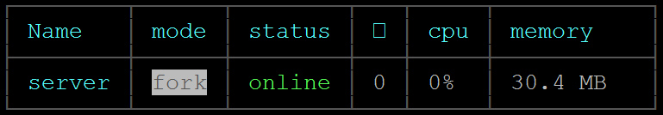

DEMONIZING THE APP: PM2
PM2 is a production process manager for Node.js applications, that has a built-in load balancer. PM2 allows you to keep applications alive forever and reload them without downtime, and will facilitate common system admin tasks. PM2 also enables you to manage application logging, monitoring, and clustering.
$ npm install pm2 -g
$ pm2 start app.js
$ pm2 list
$ pm2 show 0
$ pm2 stop 0
$ pm2 restart 0
$ pm2 delete 0
$ pm2 startup
$ pm2 save
https://github.com/Unitech/pm2

Slide 18
DEMONIZING THE APP: PM COMPARISON
Feature | StrongLoop Process Manager | pm2 | forever
Run app locally | slc start | pm2 start app.js -name foo | forever start app.js
Restart on failure | Yes | Yes | Yes
OS Startup script support | Yes | Yes | No
Security | HTTP auth and HTTP+SSH | SSH only deploy | No
Set environment vars | Available on install and with slc ctl env-set command | Available as part of ecosystem configuration | No
Log aggregation/rotation | Yes; log file and syslog | Yes; multihost, with rotation. Log file only; no syslog | No

Slide 19
DEMONIZING THE APP: PM COMPARISON
Feature | StrongLoop Process Manager | pm2 | forever
Multiple app management | Local/Remote | Local/Remote | Local only
Deploy apps to docker container | Yes | No | No
Remote deploy | Yes | Yes | No
Clustering | Available | Available | No
Profiling | Heap and CPU profiles | No | No
Metrics | CPU, memory, database, NoSQL connectors, many others | CPU, memory, stack traces reported on error output | No

Slide 20

Q&A

Slide 21
deploy AND tools
NODE.JS GLOBAL

